Slide 1
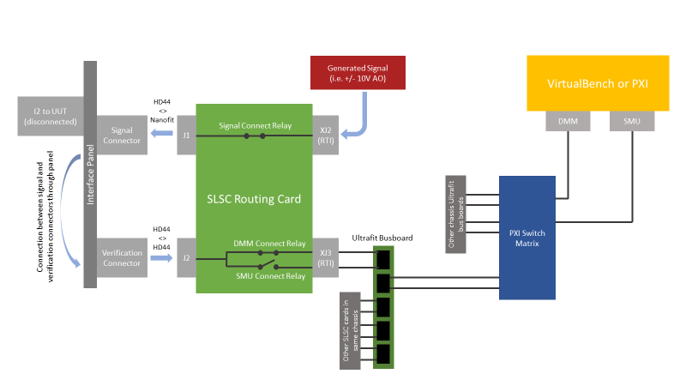
Self-Test Overview
Self-test is a method of automatically testing all signals in a test system for system verification. Common verification items tested for are faulty hardware, incorrect software configurations, and misrouted cables.
Inputs to the tester (outputs from the UUT) are verified by generating a signal with verification instrumentation (SMU), routing it to the panel connector of the signal-under-test, and then back into the system to be measured by the signal measurement hardware.
Outputs from the tester (inputs to the UUT) are verified by generating a voltage/current from the signal hardware and routing it to the panel, then routing it back into the system to be measured by verification instrumentation (DMM).

Slide 2
Interface Panel
Generated Signal
(i.e. +/- 10V AO)
VirtualBench or PXI
I2 to UUT
(disconnected)
HD44
<>
Nanofit
SLSC Routing Card
DMM
SMU
Signal Connector
J1
Signal Connect Relay
XJ2 (RTI)
PXI Switch Matrix
Connection between signal and verification connectors through panel
Other chassis Ultrafit bus boards
HD44
<>
HD44
DMM Connect Relay
Ultrafit Busboard
Verification Connector
J2
XJ3 (RTI)
SMU Connect Relay
Other SLSC cards in same chassis

Slide 3
Signal Generation
Interface Panel
Generated Signal
(i.e. +/- 10V AO)
VirtualBench or PXI
I2 to UUT
(disconnected)
HD44
<>
Nanofit
SLSC Routing Card
DMM
SMU
Signal Connector
J1
Signal Connect Relay
XJ2 (RTI)
PXI Switch Matrix
Connection between signal and verification connectors through panel
Other chassis Ultrafit bus boards
HD44
<>
HD44
DMM Connect Relay
Ultrafit Busboard
Verification Connector
J2
XJ3 (RTI)
SMU Connect Relay
Other SLSC cards in same chassis

Slide 4
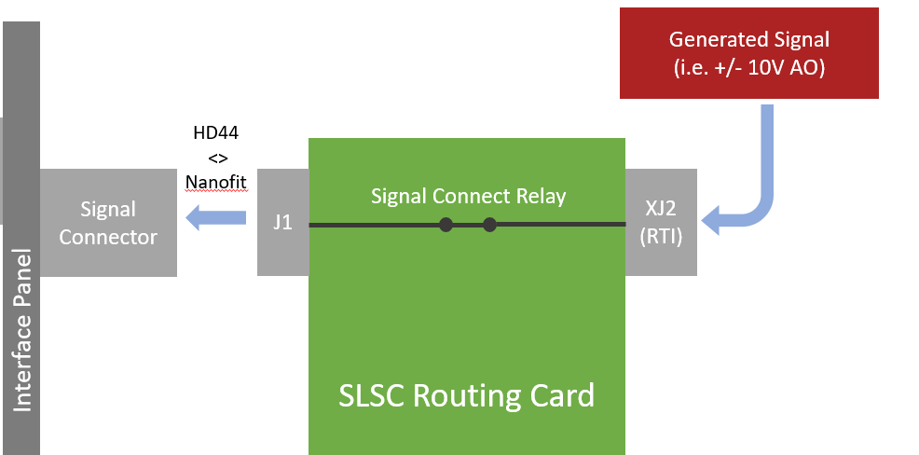
Signal Generation
1
Signal-under-test generated in PXI/SLSC and sent to connector on back of routing card.
Signal-under-test has relay to front of card connected. All other signal connect relays for other signals in the system are disconnected.
Signal connects to interface panel with HD44 <> Nanofit cable.
3
2

Slide 5
Interface Panel
Generated Signal
(i.e. +/- 10V AO)
VirtualBench or PXI
I2 to UUT
(disconnected)
HD44
<>
Nanofit
SLSC Routing Card
DMM
SMU
Signal Connector
J1
Signal Connect Relay
XJ2 (RTI)
PXI Switch Matrix
Connection between signal and verification connectors through panel
Other chassis Ultrafit bus boards
HD44
<>
HD44
DMM Connect Relay
Ultrafit Busboard
Verification Connector
J2
XJ3 (RTI)
SMU Connect Relay
Signal Duplication to Verification Connectors
Other SLSC cards in same chassis

Slide 6
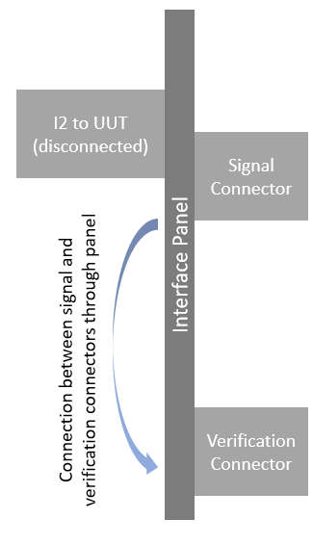
Signal Duplication to Verification Connectors
Signal-under-test routes through the panel from the Nanofit signal connector to the HD44 Verification connector to be routed back into the test rack.
1

Slide 7
Interface Panel
Generated Signal
(i.e. +/- 10V AO)
VirtualBench or PXI
I2 to UUT
(disconnected)
HD44
<>
Nanofit
SLSC Routing Card
DMM
SMU
Signal Connector
J1
Signal Connect Relay
XJ2 (RTI)
PXI Switch Matrix
Connection between signal and verification connectors through panel
Other chassis Ultrafit bus boards
HD44
<>
HD44
DMM Connect Relay
Ultrafit Busboard
Verification Connector
J2
XJ3 (RTI)
SMU Connect Relay
Instrument Bus Connection
Other SLSC cards in same chassis

Slide 8
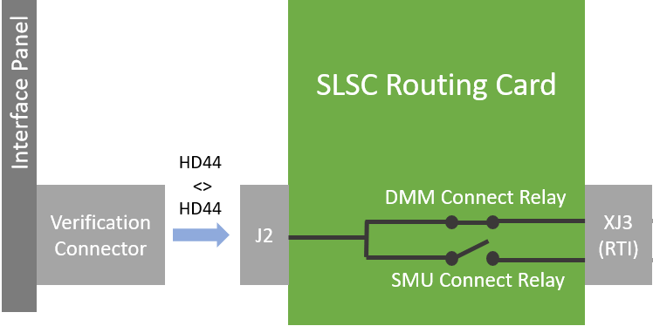
Instrument Bus Connection
Signal-under-test routed from Verification connector to Routing card J2 connector using HD44 <> HD44 cable
Signal-under-test connected to DMM bus or SMU bus using internal routing card relays
Signal-under-test appears at XJ3 Ultrafit connector on rear of SLSC routing card
2
1
3

Slide 9
Interface Panel
Generated Signal
(i.e. +/- 10V AO)
VirtualBench or PXI
I2 to UUT
(disconnected)
HD44
<>
Nanofit
SLSC Routing Card
DMM
SMU
Signal Connector
J1
Signal Connect Relay
XJ2 (RTI)
Chassis Ultrafit Busboard Connection
PXI Switch Matrix
Connection between signal and verification connectors through panel
Other chassis Ultrafit bus boards
HD44
<>
HD44
DMM Connect Relay
Ultrafit Busboard
Verification Connector
J2
XJ3 (RTI)
SMU Connect Relay
Other SLSC cards in same chassis

Slide 10
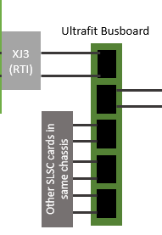
Chassis Ultrafit Busboard Connection
Signal-under-test routed onto Ultrafit busboard. Pins per connector on busboard are shorted together i.e. all pin 1s are shorted together, all pin 2s are shorted together. Note: As all signals other than the signal-under-test are disconnected, no signal collisions will occur on the bus.
Other SLSC routing cards that have self-test connections will be connected to the same busboard. There will be one busboard per chassis.
1
2

Slide 11
Interface Panel
Generated Signal
(i.e. +/- 10V AO)
VirtualBench or PXI
I2 to UUT
(disconnected)
HD44
<>
Nanofit
SLSC Routing Card
DMM
SMU
Signal Connector
J1
Signal Connect Relay
XJ2 (RTI)
PXI Switch Matrix
Connection between signal and verification connectors through panel
Other chassis Ultrafit bus boards
HD44
<>
HD44
DMM Connect Relay
Ultrafit Busboard
Verification Connector
J2
XJ3 (RTI)
SMU Connect Relay
PXI Matrix Busboard Selection
Other SLSC cards in same chassis

Slide 12
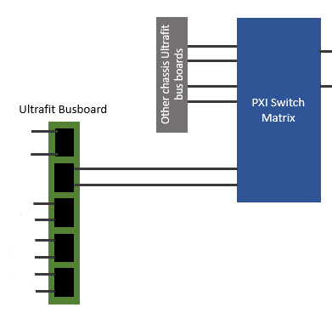
PXI Matrix Busboard Selection
All chassis busboards have one Ultrafit connected to the PXI switch matrix. As all pins on the busboard are shorted together, if there is a signal under test on any card in a chassis it will be routed on that Ultrafit connector.
The PXI switch matrix selects which chassis will be multiplexed onto the lines going to instrumentation (DMM/SMU).
2
1

Slide 13
PXI Matrix to Instrumentation
Interface Panel
Generated Signal
(i.e. +/- 10V AO)
VirtualBench or PXI
I2 to UUT
(disconnected)
HD44
<>
Nanofit
SLSC Routing Card
DMM
SMU
Signal Connector
J1
Signal Connect Relay
XJ2 (RTI)
PXI Switch Matrix
Connection between signal and verification connectors through panel
Other chassis Ultrafit bus boards
HD44
<>
HD44
DMM Connect Relay
Ultrafit Busboard
Verification Connector
J2
XJ3 (RTI)
SMU Connect Relay
Other SLSC cards in same chassis

Slide 14
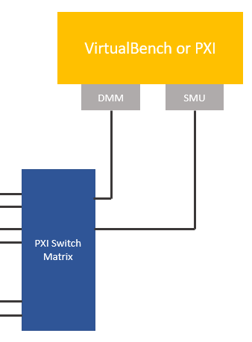
PXI Matrix to Instrumentation
Signal-under-test- routes from PXI switch matrix to DMM for measurement. In the case of an input to the tester (output from the UUT), this path is reversed and a voltage is generated by the SMU, routed through the switch matrix to a chassis busboard, routed through SLSC, and appears at the panel to be measured by the signal measurement hardware.
1

